Slide 1
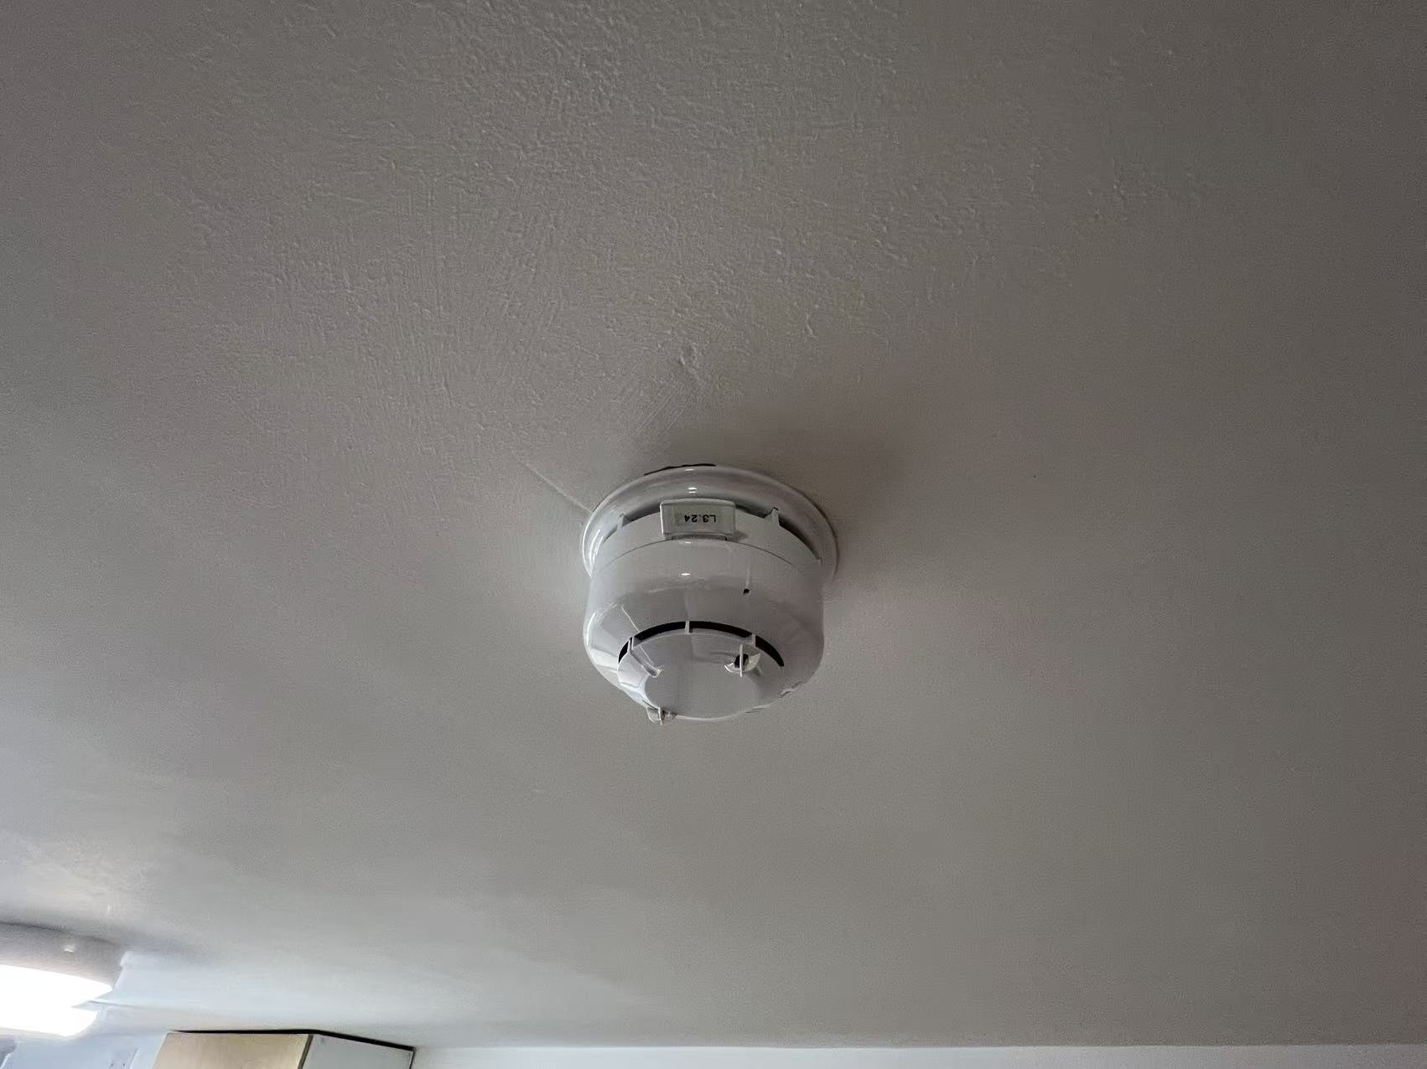
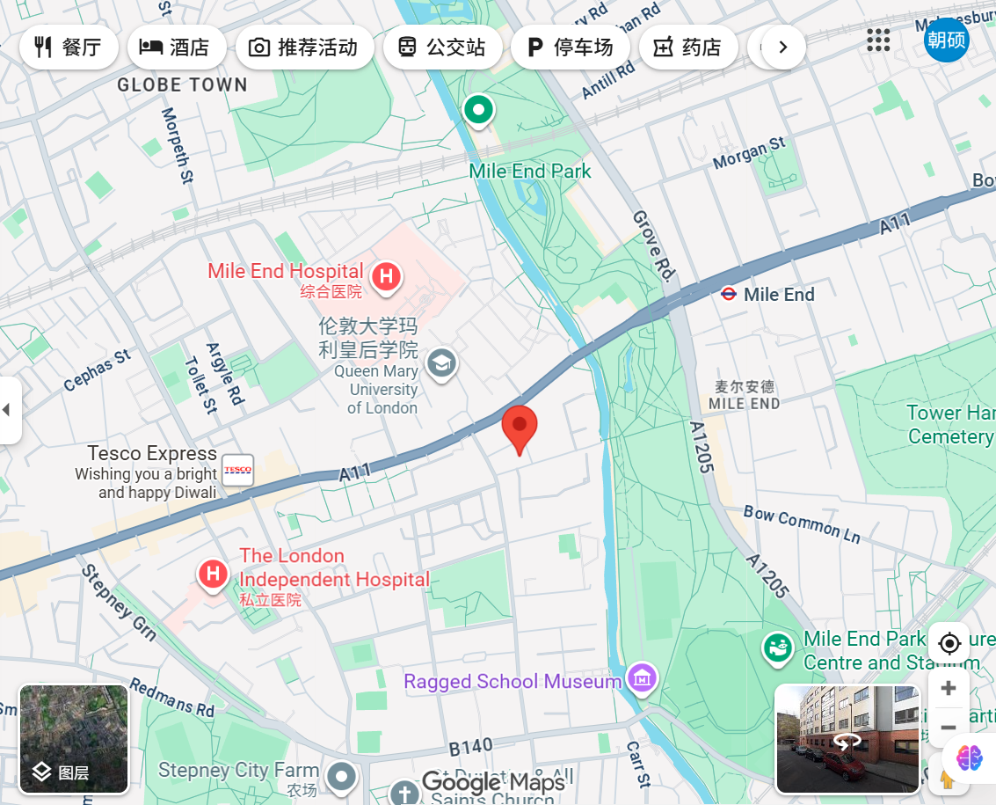
Smoke Detector System
This smoke detector is a household fire safety device designed to detect smoke particles in the air and provide early warning of potential fire hazards.
It works by using a sensor that detects light scattering caused by smoke. Once smoke concentration exceeds a threshold, the alarm emits a loud sound to alert occupants.
Such systems are essential for residential and public safety, helping to reduce fire-related injuries and property loss.
Questions when visiting site?
How does a smoke detector sense smoke in the air?
Why is regular maintenance important?
Location info:
Rahere Court
E1 4DW
https://maps.app.goo.gl/fmHp1AtANi4JTUQQ7
Submitted: Chaoshuo Han Oct 2025
Notes:
A title and a couple of sentences describing the technology and possibly linking to further information online.
A photo of the technology in situ with a corresponding map showing where it is.
2 or 3 questions that you might ask when you are in situ at the site of the technology to engage others in a discussion about that technology
The following geographic data:
Lat Long
Street Address
Google maps link
What3words location
Also add in the names of those submitting this data.

Slide 2
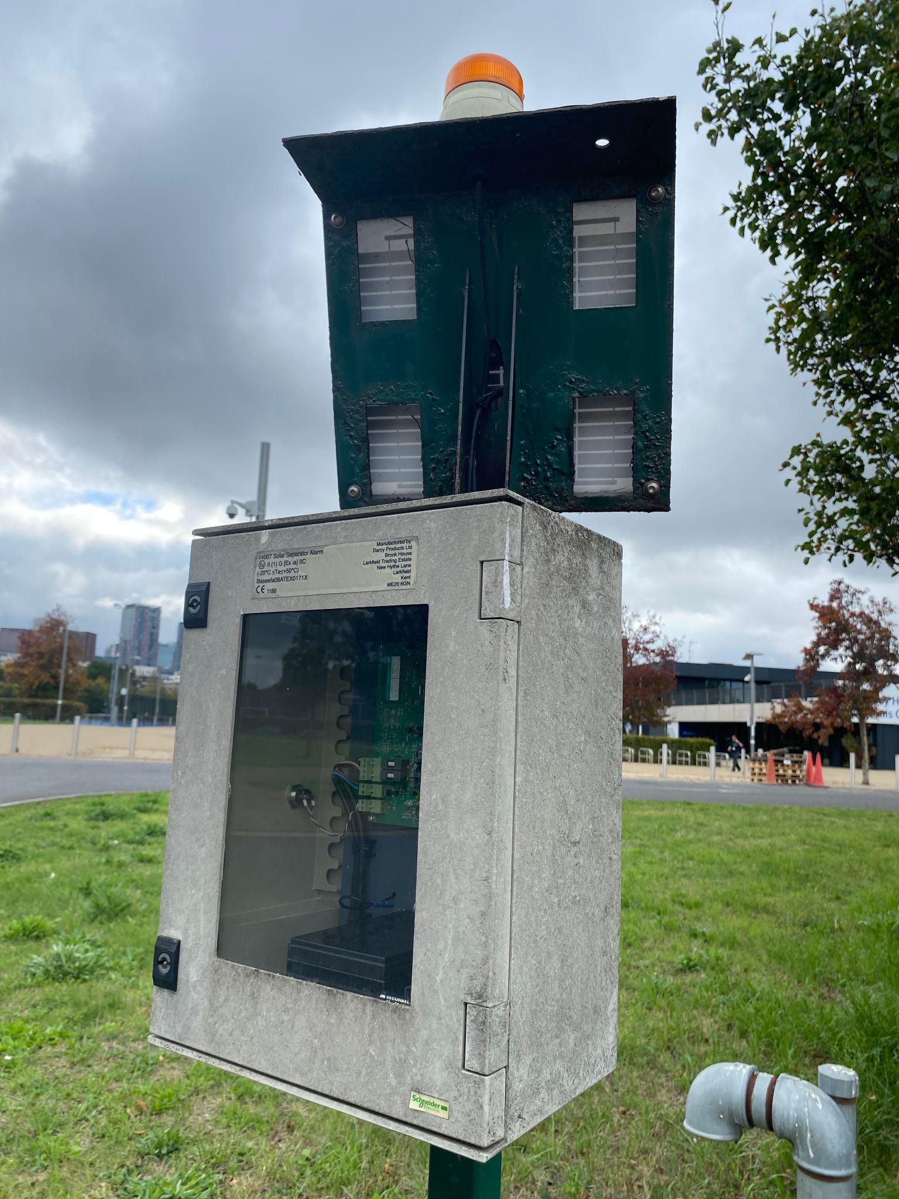
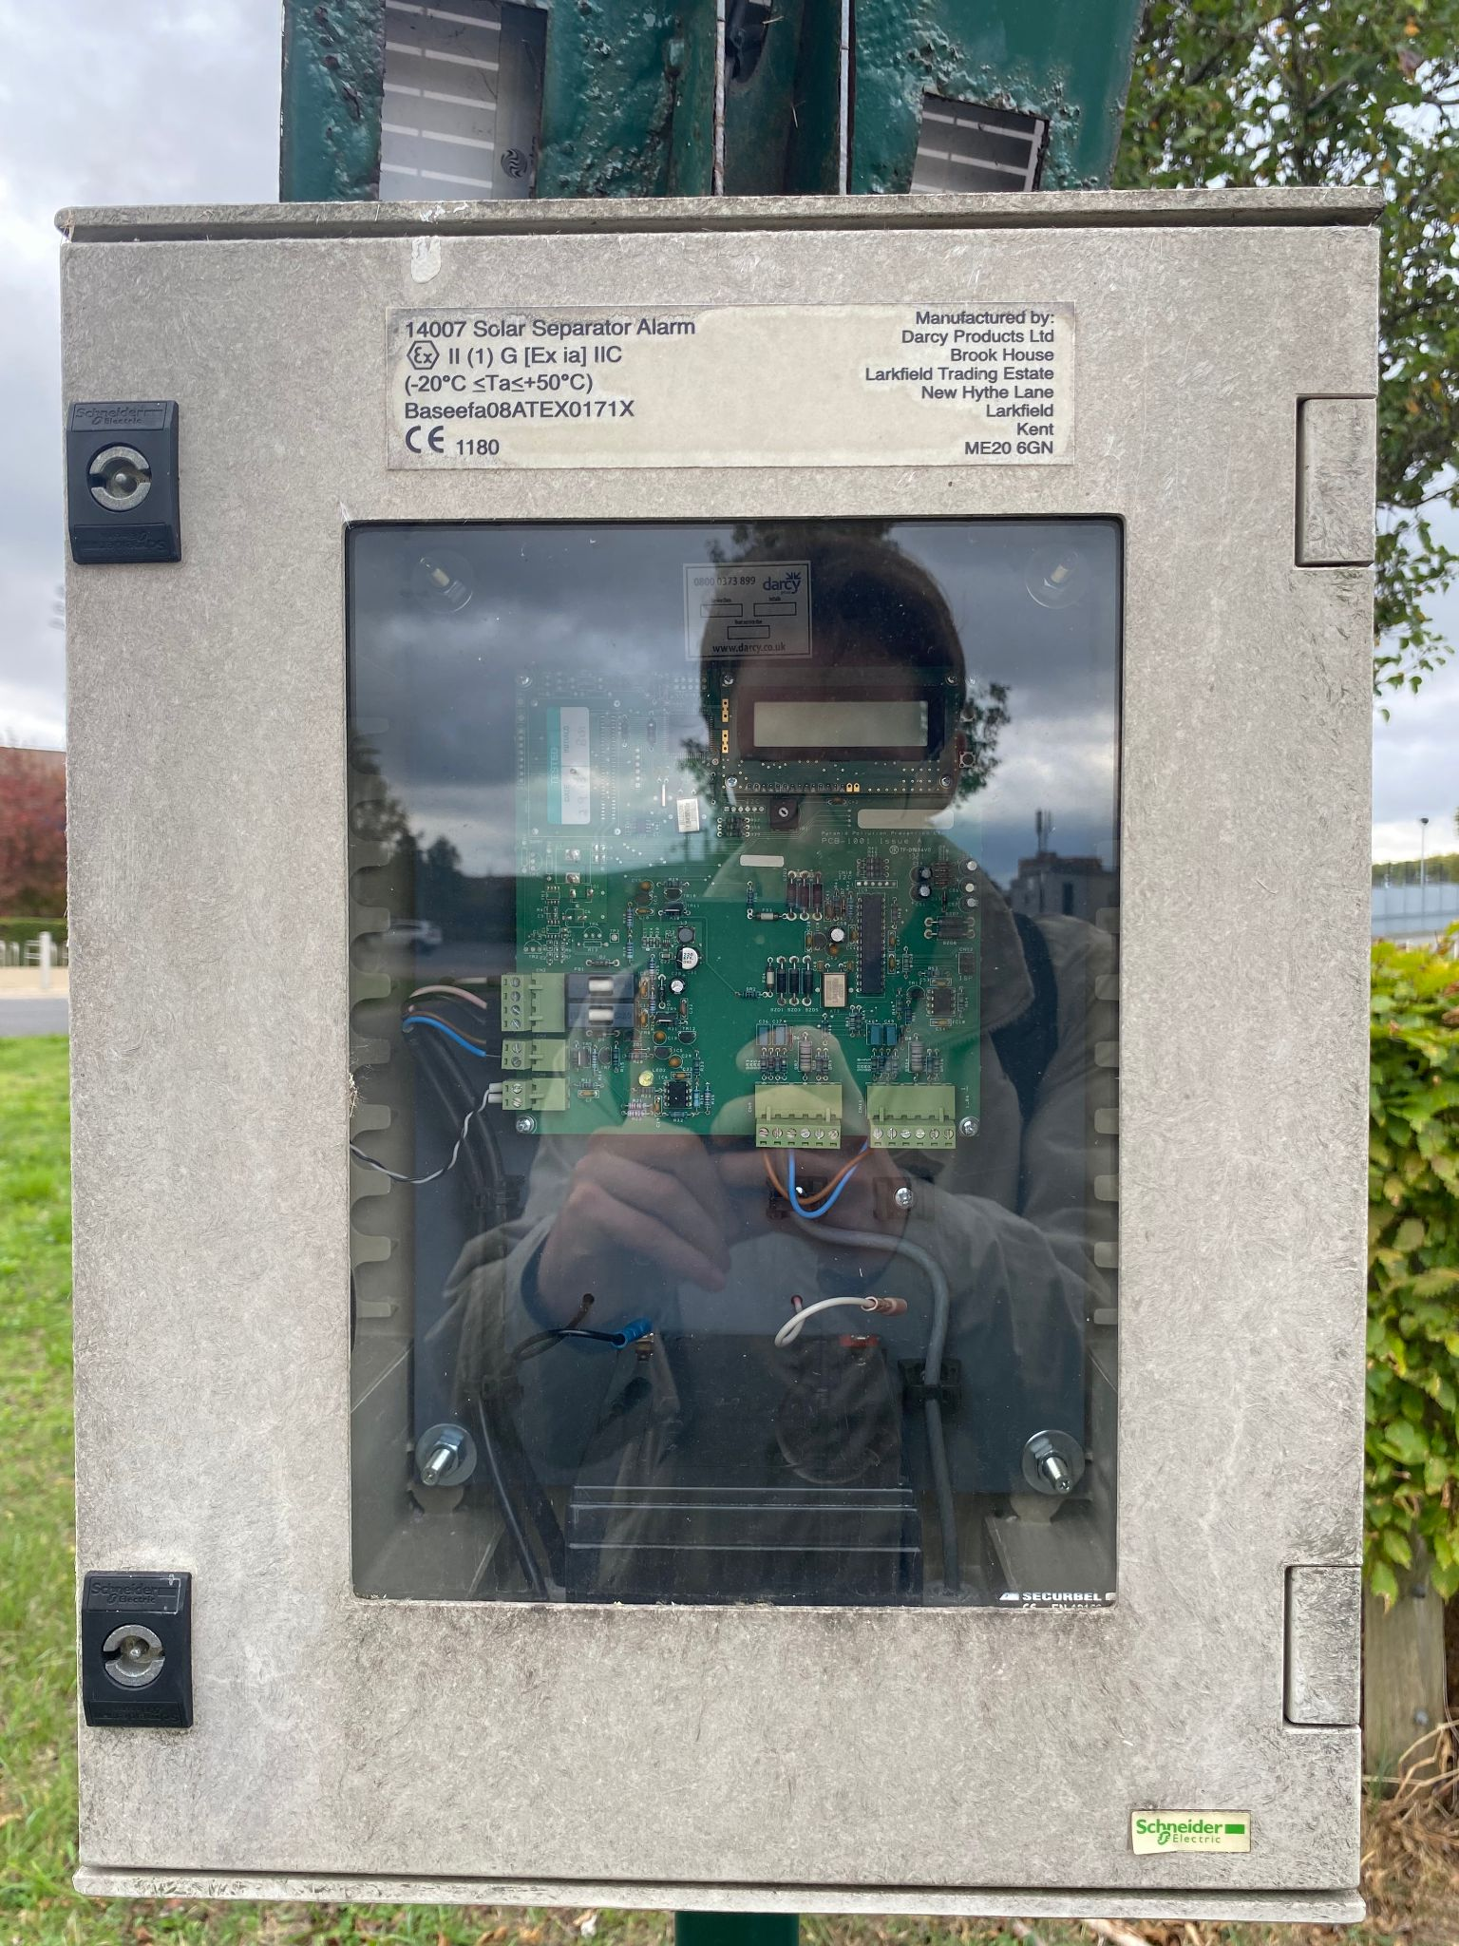
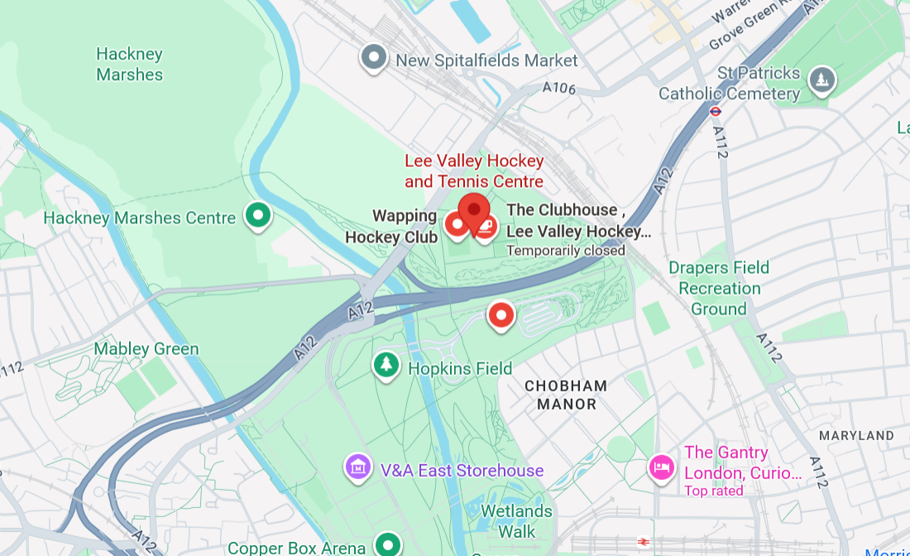
Solar-powered oil/water separator alarm
This device monitors the operation of an oil/water separator underground. When the separator fails, contaminants such as oil and suspended solids are not filtered out of the water, which could lead to a larger pollution incident.
Upon detecting abnormal levels of contaminants in the water, the device sends an SMS alert to authorised individuals and emits an orange flashing light.
Questions when visiting site?
Why is the box so big, compared to the hardware inside?
Why did they design the box so I can see the internals?
Who receives the data, and who is sent to fix the problem?
Location info:
@51.554017209709706, -0.01587127934155465
Eton Manor, Queen Elizabeth Olympic Park, Leadmill Ln, London E20 3AD
https://maps.app.goo.gl/pwBTZGeKLEKtQRAd7
what3words: ///mouse.allows.follow
Submitted: Ethan Taylor Oct 2025
Notes:
A title and a couple of sentences describing the technology and possibly linking to further information online.
A photo of the technology in situ with a corresponding map showing where it is.
2 or 3 questions that you might ask when you are in situ at the site of the technology to engage others in a discussion about that technology
The following geographic data:
Lat Long
Street Address
Google maps link
What3words location
Also add in the names of those submitting this data.

Slide 3
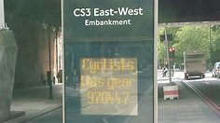
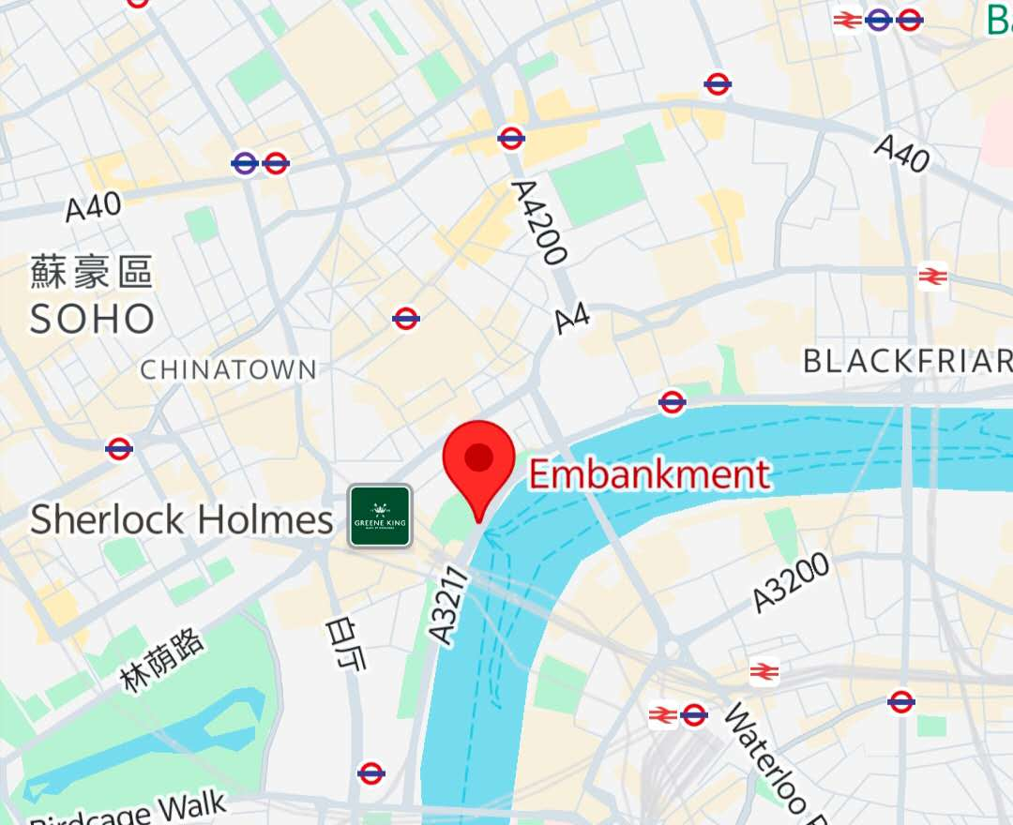
Cycle Counters and
Smart Digital Cycle Totem.
The image shows London's Smart Digital Cycle Totem, located along cycle superhighways and major cycling routes. It relies on piezoelectric sensors embedded beneath the lane surface, generating an electrical charge as bicycles pass by, which is then used to count them. An LED screen above displays the number of riders for the day and the cumulative total, making this data visible to the public.
Questions when visiting site?
What are the practical applications of such data?
Why should the annual number of cyclists be shown to pedestrians as shown in the picture?
Are there any ongoing operating costs associated with the project?
Location info:
Embankment Station, London WC2N 6PB
https://maps.app.goo.gl/PcKWJ6cSknWnTwBv8?g_st=awc
Submitted: Qingshan Luo Oct 2025
Notes:
A title and a couple of sentences describing the technology and possibly linking to further information online.
A photo of the technology in situ with a corresponding map showing where it is.
2 or 3 questions that you might ask when you are in situ at the site of the technology to engage others in a discussion about that technology
The following geographic data:
Lat Long
Street Address
Google maps link
What3words location
Also add in the names of those submitting this data.

Slide 4
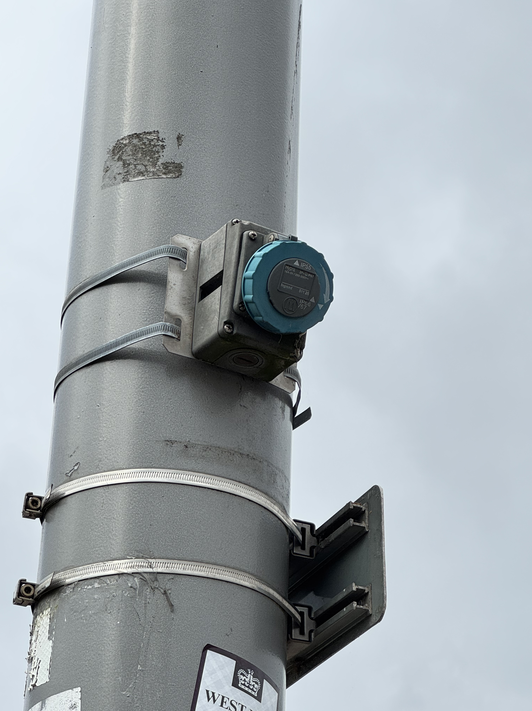
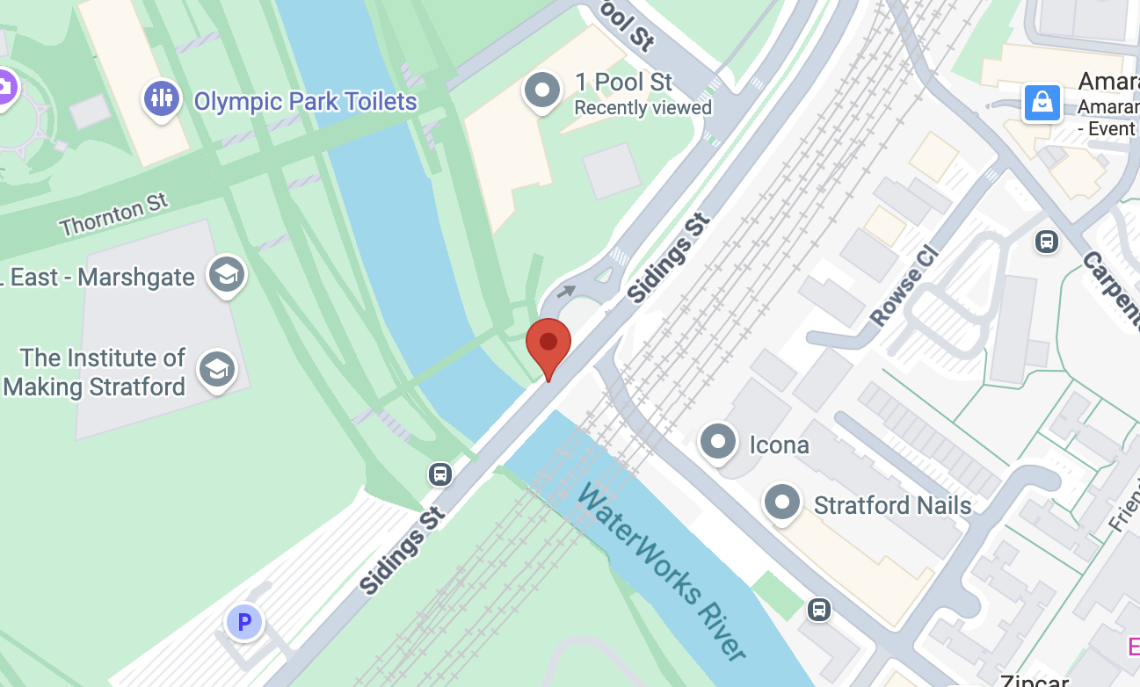
Smart Park Connectivity – SPARK® Wi-Fi.
This device is part of the digital infrastructure at Queen Elizabeth Olympic Park (QEOP). Using SPARK platform by WIFI SPARK, they provides free public WIFI.
Further info: GLA DATA CITY report (WiFi SPARK provides Smart Park connectivity)；SPARK TSL public-WiFi solution for QEOP；G-Cloud service definition.
Questions when visiting site?
What data do these SPARK Wi-Fi nodes collect?
What backhaul does this node use?
Who is this technology for?
Location info:
@51.537434, −0.009600
One Pool Street, London E20 2AF
https://maps.app.goo.gl/or1ck3rHRSqZwy3F8
what3words: ///raced.ranged.refuse
Submitted: Yidan Gao 2025
Notes:
A title and a couple of sentences describing the technology and possibly linking to further information online.
A photo of the technology in situ with a corresponding map showing where it is.
2 or 3 questions that you might ask when you are in situ at the site of the technology to engage others in a discussion about that technology
The following geographic data:
Lat Long
Street Address
Google maps link
What3words location
Also add in the names of those submitting this data.

